Slide 1
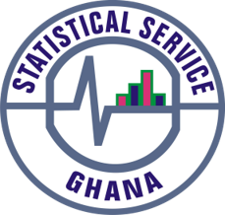
PRESS RELEASE
GHANA, May 2022
CONSUMER PRICE INDEX AND INFLATION
8th June 2022

Slide 2
In this release, we present:
Definition and Measurement of Consumer Price Index (CPI) and Rate of Inflation
CPI and Rate of Inflation for May 2022
Dominant Divisions of Rate of Inflation for May 2022
Disaggregation of Rate of Inflation for May 2022
Highlights of CPI and Rate of Inflation for May 2022

Slide 3
Definition and measurement of CPI and rate of inflation (1/3)
CPI measures changes in the price of a fixed basket of goods and services purchased by households
The assumption is that the basket is purchased each month, hence as price changes each month, the total price of the basket will also change
The rate of inflation is the relative change in CPI between periods
Inflation is reported year-on-year (annual inflation) and month-on-month (monthly inflation), and granulated to determine regional and commodity type and source of inflation
2
2

Slide 4
Definition and measurement of CPI and rate of inflation (2/3)
CPI does not measure price levels
CPI is a price perspective measure and cost-of-living index is an expenditure oriented measure
Data (market readings) are captured monthly
Key variables are prices, quantities and expenditure weights of items
Price reference year is 2018 (2018 = 100)
3

Slide 5
Definition and measurement of CPI and rate of inflation (3/3)
Prices are collected for approximately 39,500 products every month.
Price collection is done in 44 markets
Prices are collected from 7,726 outlets.
Products are ordered in a hierarchy of 13 Divisions, 44 Groups, 98 Classes, 156 Subclasses and 307 Items.
Every Item can only be part of one Subclass, and every Subclass can only be part of one Class, etc.
4

Slide 6
Consumer Price Index and Rate of Inflation for May. 2022
CPI for May 2022 was 162.8 relative to 127.6 in May 2021
Year-on-year inflation rate for May 2022 was 27.6%
This means that in the month of May 2022 the general price level was 27.6% higher than May 2021
Month-on-month inflation between April 2022 and May 2022 was 4.1%
Month | CPI | Inflation |  | Quarterly Averages
 |  | Monthly | Yearly | Quarterly Averages
Apr-2021 | 126.6 | 1.5% | 8.5% | Q2: 7.9%
May-2021 | 127.6 | 0.8% | 7.5%
June-2021 | 129.2 | 1.3% | 7.8%
Jul-2021 | 131.3 | 1.6% | 9.0% | Q3: 9.8%
Aug-2021 | 131.7 | 0.3% | 9.7%
Sept-2021 | 132.5 | 0.6% | 10.6%
Oct-2021 | 133.3 | 0.6% | 11.0% | Q4: 11.9%
Nov-2021 | 135.2 | 1.4% | 12.2%
Dec-2021 | 136.9 | 1.2% | 12.6%
Jan-2022 | 139.7 | 2.1% | 13.9% | Q1: 16.3%
Feb-2022 | 143.0 | 2.4% | 15.7%
Mar-2022 | 148.8 | 4.0% | 19.4%
Apr-2022 | 156.5 | 5.1% | 23.6%
May-2022 | 162.8 | 4.1% | 27.6%
5
Notes:
In May 2022, year-on-Year inflation increases by 4.0 percentage points (from 23.6% to 27.6%) and Month-on-Month inflation reduces by 1.0 percentage points (from 5.1% to 4.1%).
In the first quarter of 2022, the average inflation was 16.3%, relative to 10.2% recorded for the same period in 2021.

Slide 7
Disaggregation of May 2022 rate of inflation
Food inflation was 30.1%
  Last month this was 26.6%
  Average over last 12 month was 13.5%
  Month-on-month Food inflation was 4.0%.
Non-food Inflation was 25.7%
  Last month this was 21.3 %
  Average over last 12 month was 15.5%
  Month-on-month Non-Food inflation was 4.1%
Inflation for locally produced items was 27.3%
Inflation for imported items was 28.2%
6
Notes:
The margins between food and non-food inflation was 4.4 percentage points relative to 5.4 percentage points for March () and 5.3 percentage points for April 2022
Between April and May 2022, Food Inflation went up by 3.5 percentage points (from 26.6% to 30.1%) and Non-food Inflation 4.4 percentage points (from 21.3% to 25.7%)
Food inflation for May 2022 relative to the rolling average for the period June 2022 to May 2022 has more than doubled
The margin between month-on-month food and non-food is 0.1 percentage points with food inflation recording 4.0% and non-food 4.1%
Imported inflation (28.2%) sustains its dominance over domestic inflation (27.3%) with a margin of 0.9 percentage points

Slide 8
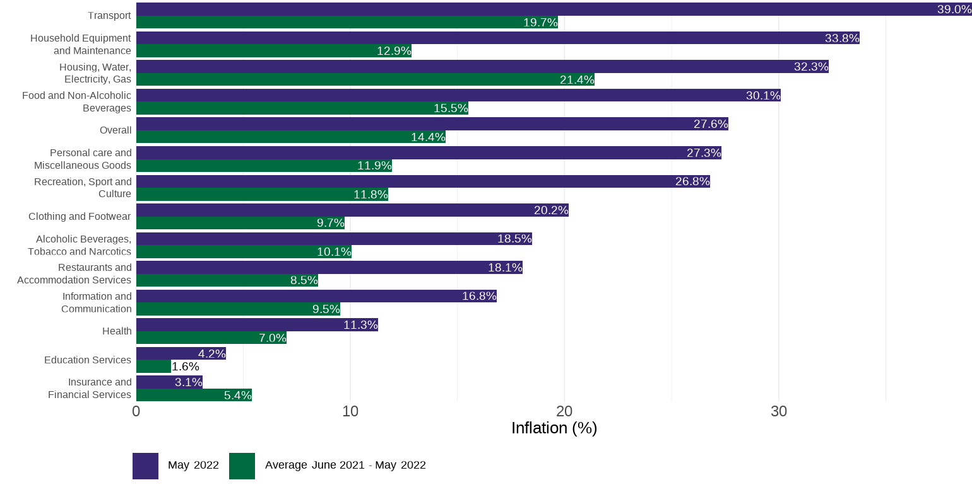
Disaggregation of year-on-year inflation by Division
7
Notes:
Transport (39.0%), Household Equipment and Maintenance (33.8%), Housing, Water, Gas and Electricity(32.3%) and Food and Non-Alcoholic Beverages (30.1.6%) and to record rates higher than the national average (27.6%).
In May 2022, twelve of the thirteen divisions record inflation rates higher than the rolling average from June 2021 to May 2022
Insurance and Financial Services is the only division that recorded an inflation rate for May 2022 that is lower that the rolling average for the period June 2021 to May 2022

Slide 9
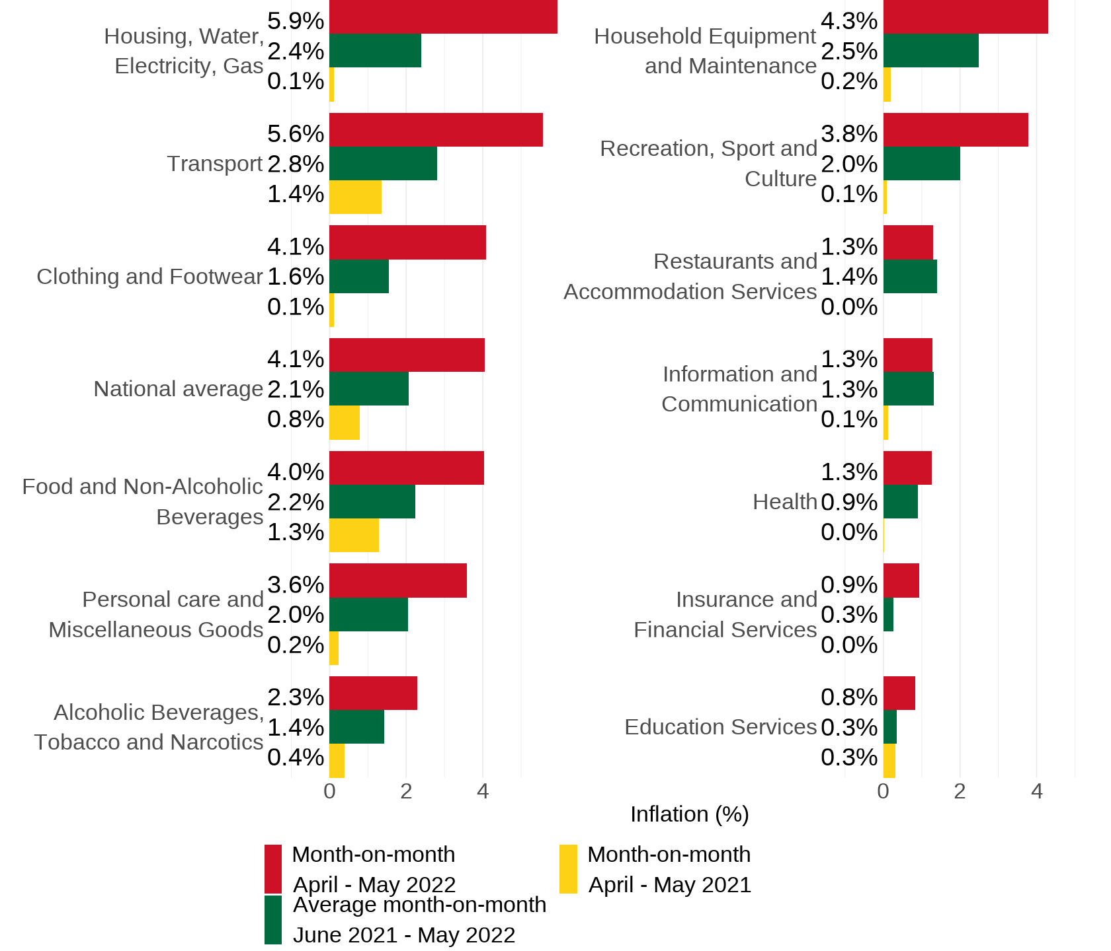
Disaggregation of month-on-month inflation
Notes:
On a month-on-month basis for May 2022, four divisions (Housing, Water, Electricity and Gas (5.9%), Household Equipment and Maintenance (4.3%), Transport (5.6%) and Clothing and Footwear (5.3%), record inflation rates either higher than or equal to the national average (4.1%).
On a month-on-month basis, Restaurants and Accommodation Services (1.3%) is the only division that recorded an inflation rate for May 2022 that is lower than the April 2022 (1.4%)

Slide 10
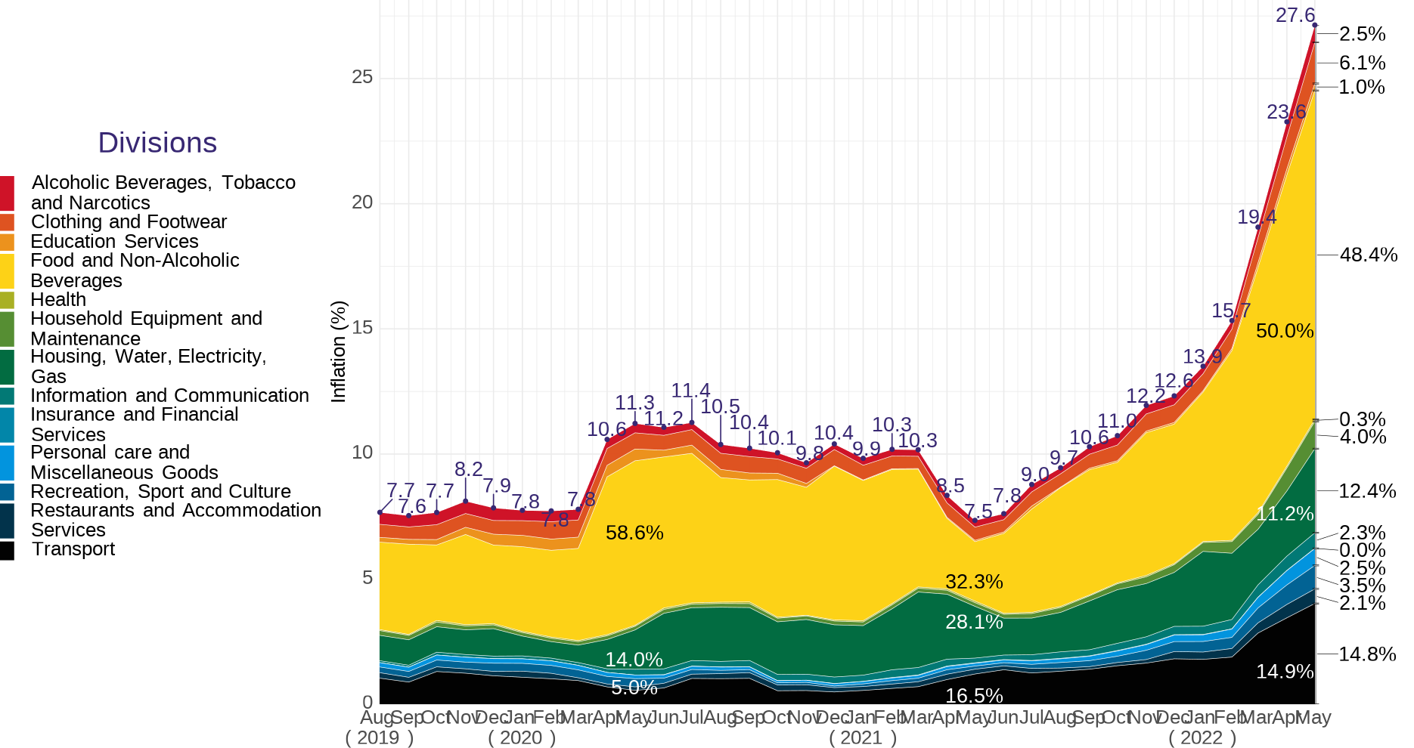
Contribution of year-on-year inflation
9
Notes:
Housing, Water, Electricity and Gas (12.4%) recorded a 1.4 percentage point increase in its contribution to overall inflation while Food and Non-alcoholic Beverages saw a reduction by 1.6 percentage points (from 50.0% to 48.4%) and Transport dipping marginally by 0.1 percentage points (from 14.9% to 14.8%).

Slide 11
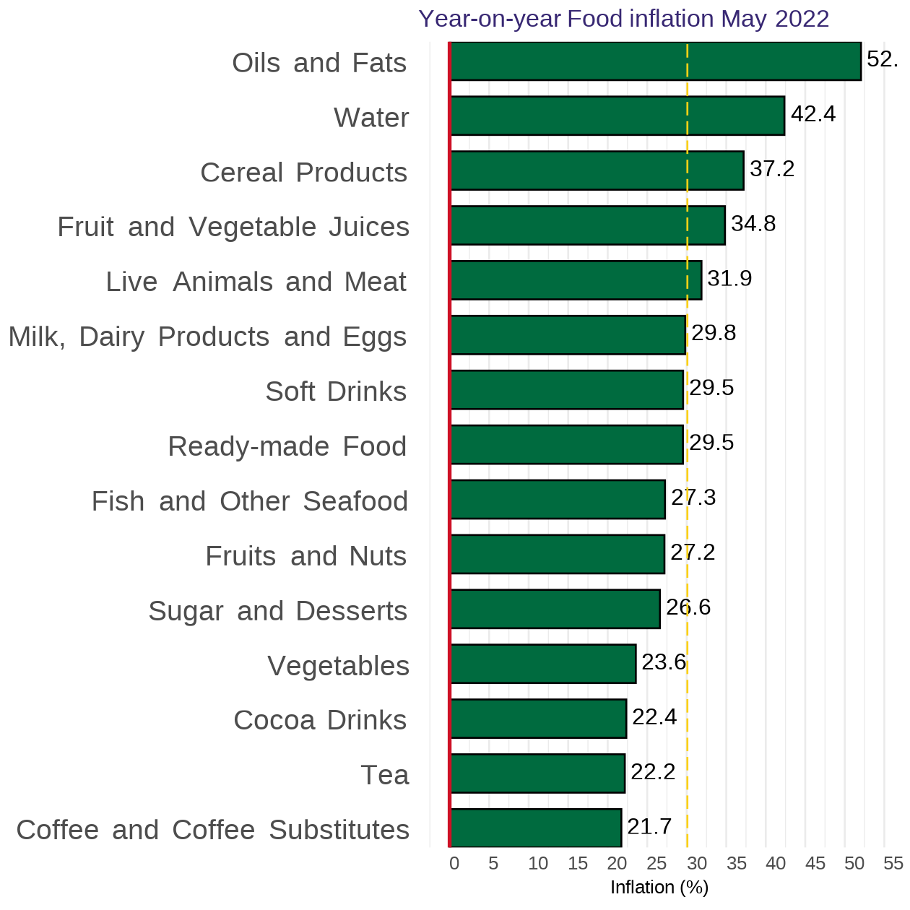
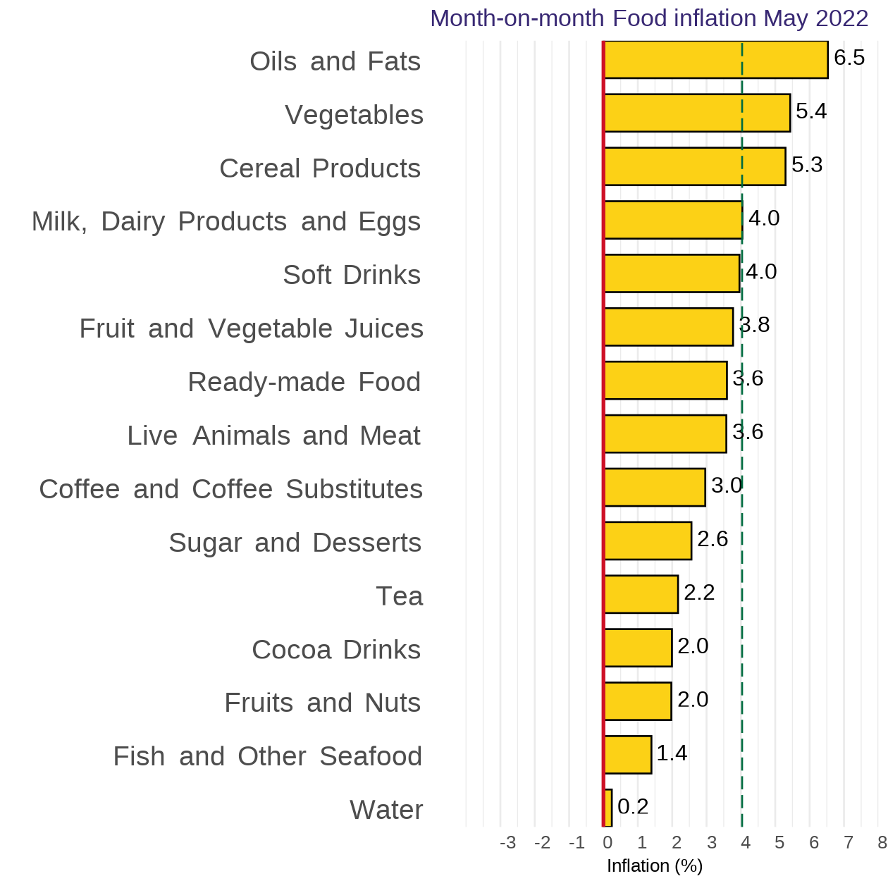
Disaggregation of YoY and MoM Food-inflation by Subclass
10
Notes:
Focusing on year-on-year food inflation for May 2022, five sub-classes record inflation rates higher than the overall food inflation (30.1%). This was distantly led by Oils and Fats (52.0%) followed by Water (42.4%).
On a month-on-month basis, three sub-classes recorded inflation rates higher than the overall inflation (4.0%). This was led by Oil and Fats (6.5%) followed by Vegetables (5.4%) and Cereal Products (5.3%)

Slide 12
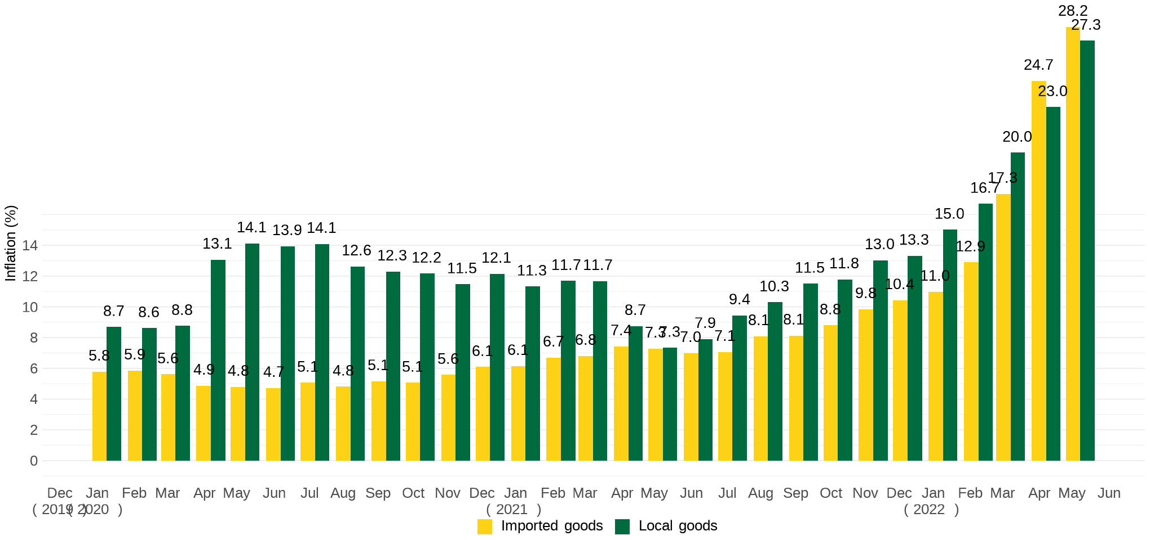
Imported and local inflation January 2020 – May 2022
Notes:
The inflation for imported goods was 28.2% (which is higher than the 24.7% recorded for April 2022) while the
inflation for locally produced items was 27.3% (up from the 23.0% recorded in April 2022).

Slide 13
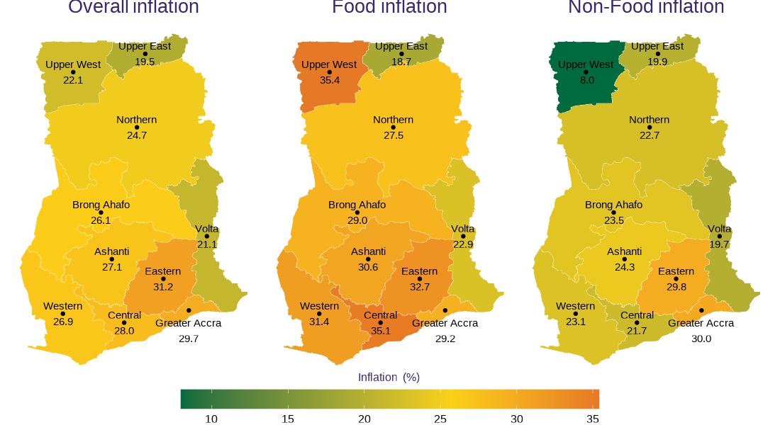
May 2022 regional rates of inflation
12

Slide 14
Disaggregation of inflation in Eastern and UW Regions for May 2022
13

Slide 15
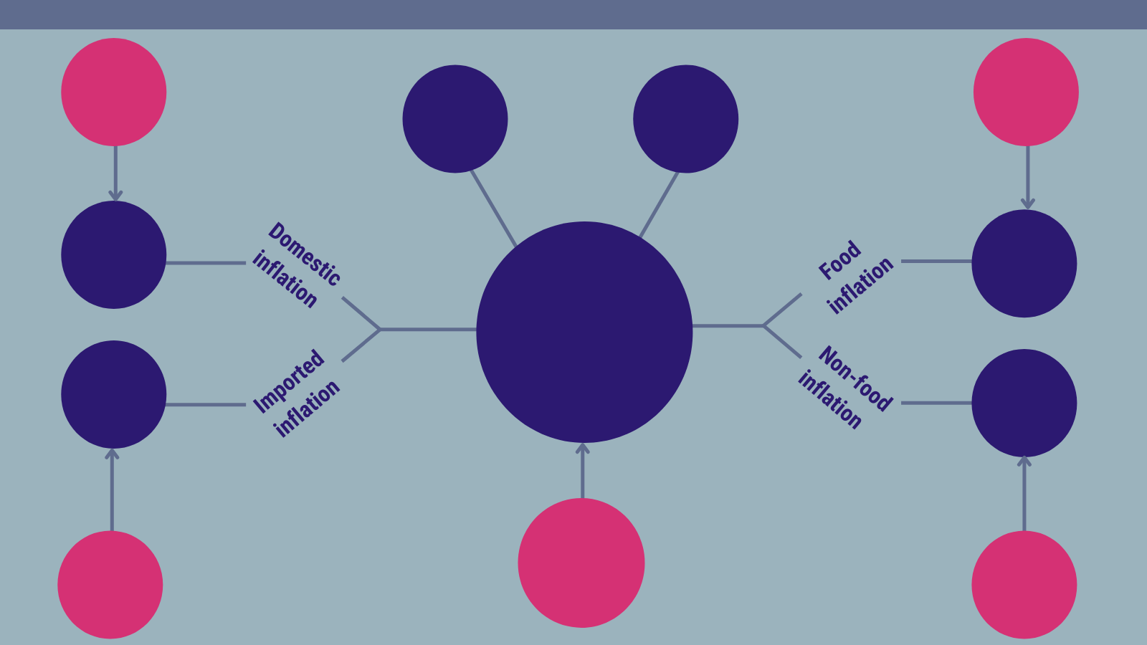
Highlights
23.0%
Domestic inflation
April 2022
26.6%
Food inflation
April 2022
31.2%
Highest regional inflation rate
(Eastern)
19.5%
Lowest regional inflation rate
(Upper East)
27.3%
30.1%
27.6%
Year-on-year inflation
May 2022
28.2%
25.7%
23.6%
Year-on-year inflation
April 2022
24.7%
Imported inflation
April 2022
21.3%
Non-food inflation
April 2022

Slide 16
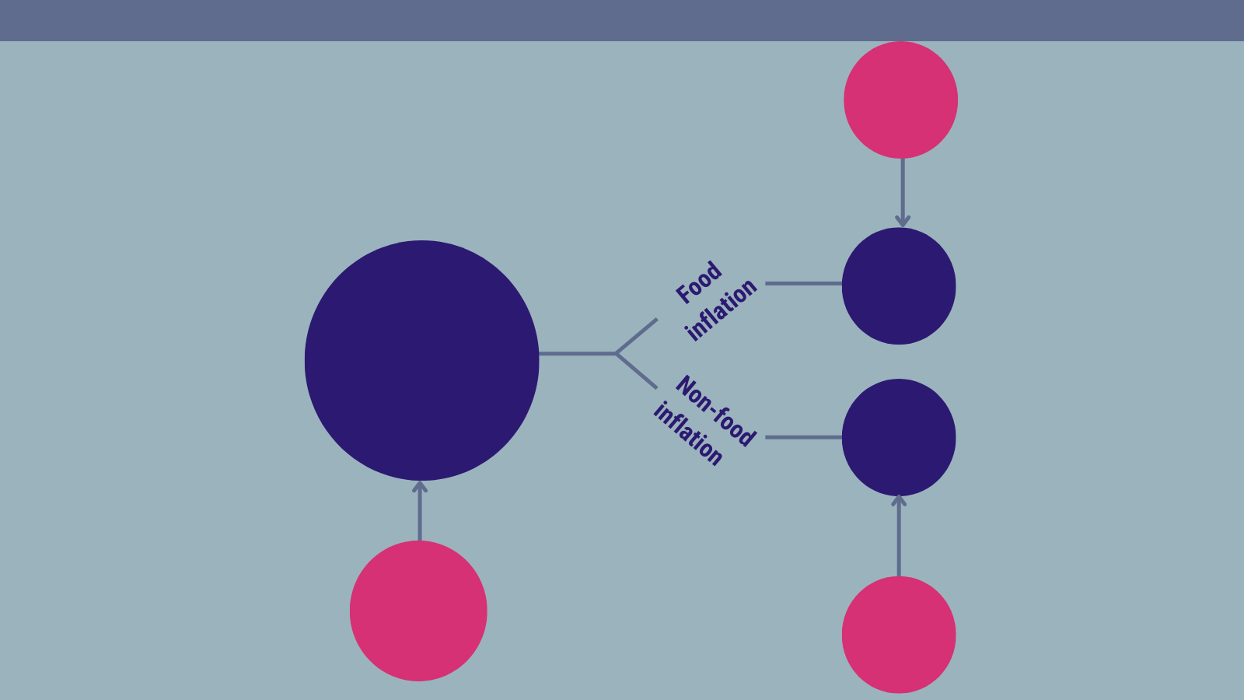
Highlights (2/2)
5.8%
Food inflation
April 2022
4.1%
Month-on-month inflation
May 2022
4.0%
4.1%
5.1%
Month-on-month inflation
April 2022
4.6%
Non-food inflation
April 2022

Slide 17
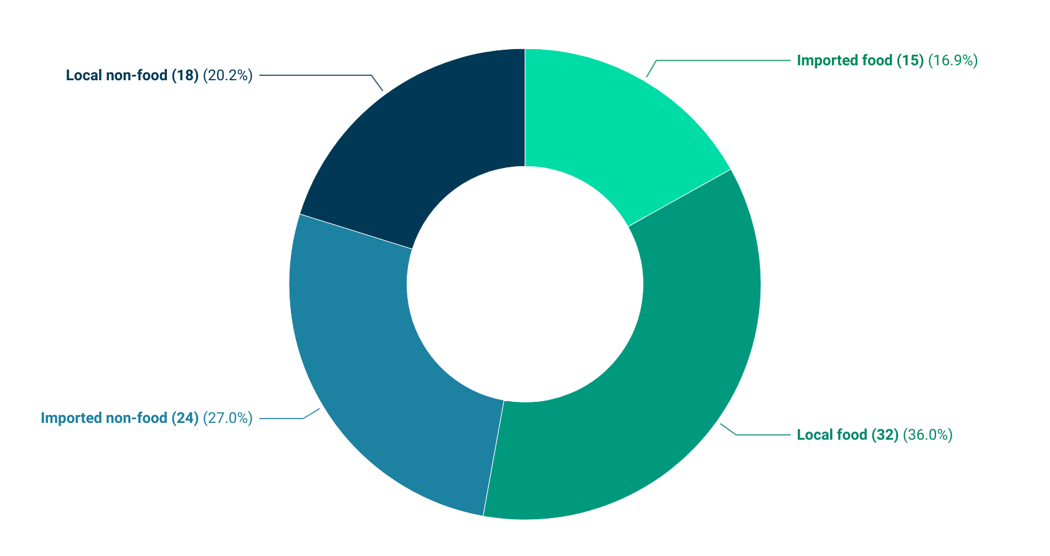
Additional Policy Considerations (1/2)
16
Notes:
Eighty-nine items recorded inflation rates higher than the national average (27.6%).Food (47) constituted 52.9% comprising Imported Food 16.9% and Local food 36.0%. Forty-two items were non-food.

Slide 18
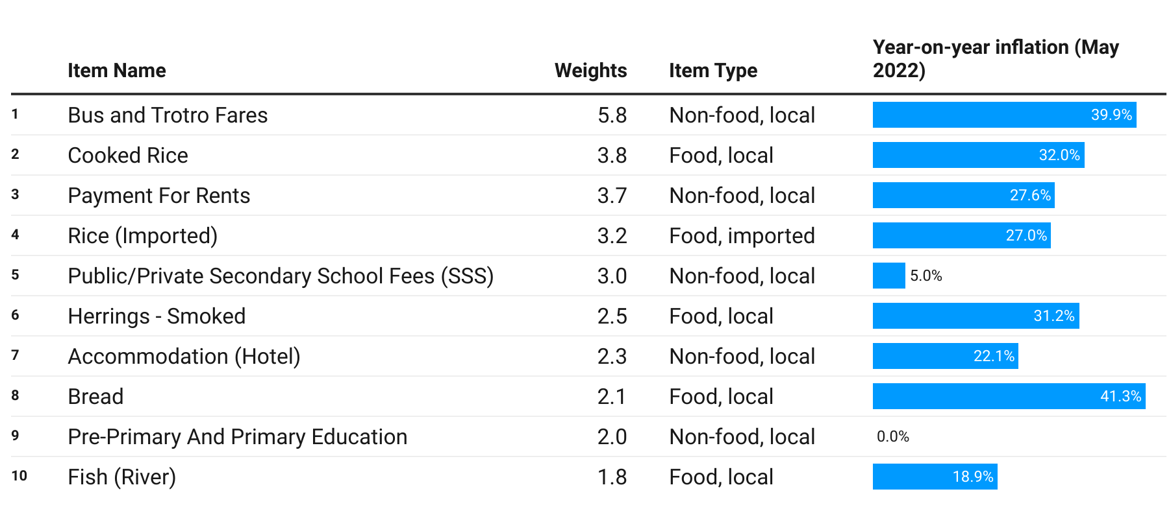
Additional Policy Considerations (2/2)
17
Notes:
Among the top 10 items with the highest weight, Bread recorded the highest inflation of 41.3% followed by Bus and Trotro Fares 39.9%.

Slide 19
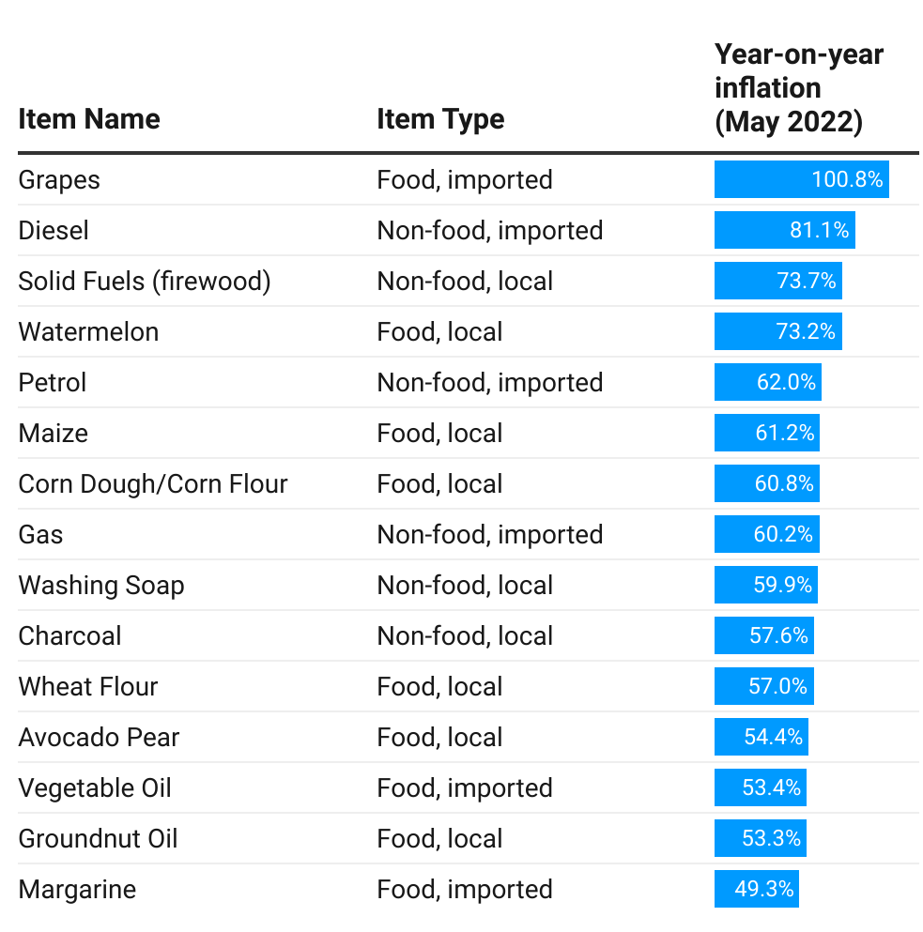
Additional Pointers for Household Decision Making
The inflation rates recorded each month have differential impacts on household depending on the basket of items purchased by each household.
Given households’ taste, disposal income and availability of alternatives, the basket of items purchased can be varied in response to the soaring prices.
Top fifteen items with the highest upward change in year-on-year inflation rates for April 2022.
18

Slide 20
End of Press Release for
May 2022 Consumer Price Index
For enquiries, please contact:
https://statsghana.gov.gh/gssmain/fileUpload/Price%20Indices/CPI_Technical_Guide_v5_Published_14102020.pdf
Mr. John F.K. Agyaho
(Head, Price Statistics, GSS)
john.agyaho@statsghana.gov.gh

Slide 21
Consumer Price Index and Inflation
May 2022

